Slide 1

AgritechGuard An Integrated Automated Farming and Security System
Team Members: Chitluru Venkata Bhanu Prakash - S20200020255
BTP Code : B23PB01
Project Mentor: Dr. Paul Braineard

Slide 2
OUTLINE
INTRODUCTION
LITERATURE REVIEW
OBJECTIVES
PROPOSED METHODOLOGY
HARDWARE TOOLS USED
SOTWARE TOOLS USED
BLOCK DIAGRAM
WORK DONE
RESULTS
CHALLENGES FACED
REFERENCES

Slide 3
INTRODUCTION
Farmers face challenges like: 1. More often visits to monitor water pump,
2. Limited water resources,
3. Untimely electricity,
4. Labor shortages,
5. Crop theft.
Rural areas often struggle with unreliable internet access.
AgritechGuard enhances farming efficiency, reduce manual labor, and empower farmers with real-time monitoring and control.
Secure boundaries using computer vision.

Slide 4
LITERATURE REVIEW
Reference-1: This literature discusses automated irrigation systems that aim to conserve water and how it implemented.
Reference-2: This literature explores the utilization of sensor data transmission via wireless communication in the presence of internet connectivity.
Reference-3: YOLO v8 person detection.
Reference-4: This literature introduces various Energy Harvesting techniques.

Slide 5
OBJECTIVES
The primary objective of this project is to reduce the amount of time farmer needed to spend in the field.
Solar energy harvesting is employed to ensure sustainable power supply.
Data transmission even if there is no internet connection.
Secure boundaries using computer vision.

Slide 6
PROPOSED METHODOLOGY
Create a system that will allow user to operate water pump remotely or leave it to the automated system.
Energy harvesting technique employed for sustainable power supply.
Data can be transmitted to long distances using LoRaWAN technology in remote areas.
Trespasser detection system using YOLO v8 model and COCO dataset to detect various anomalies.

Slide 7
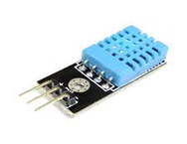
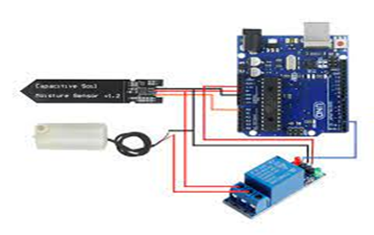
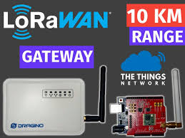
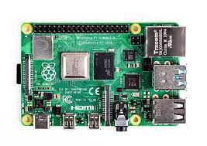
HARDWARE TOOLS USED
DHT11
Soil moisture sensor
Relay module
Water Pump
Arduino Uno
LoRa Tx & Rx
Raspberry Pi 3
LCD display
Camera Module

Slide 8
SOFTWARE TOOLS USED
Arduino IDE
Raspberry Pi Imager
Putty
VNC Viewer
PyCharm
YOLO v8
Coco Dataset
ThingSpeak Database
Embedded C
RadioHead-master
LiquidCrystal_I2C
LiquidCrystal
DHT_sensor_library
Python
OpenCV
Ultralytics
Pytorch
Numpy

Slide 9
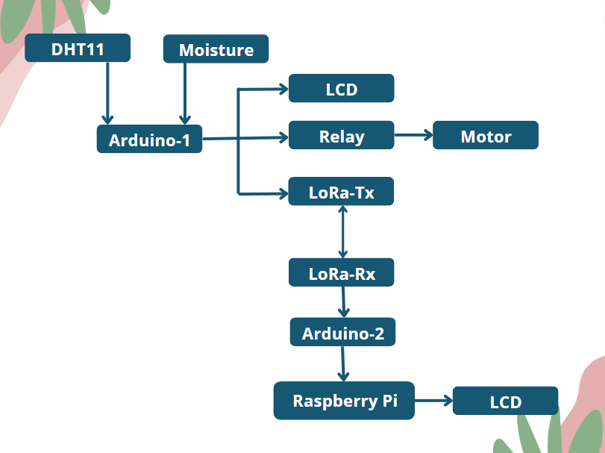
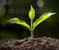
BLOCK DIAGRAM

Slide 10
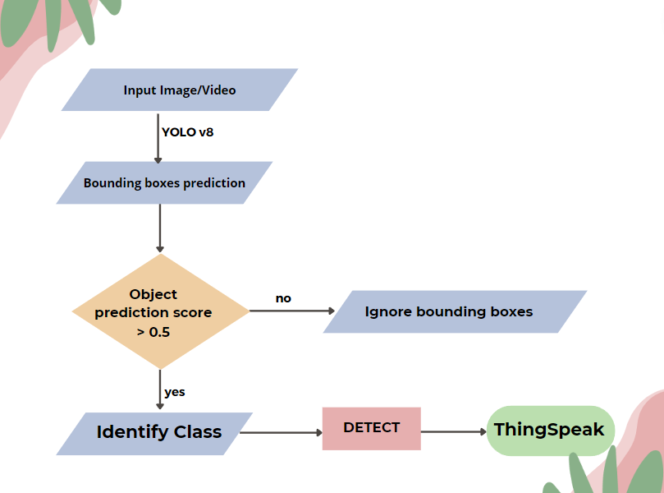
BLOCK DIAGRAM

Slide 11
WORK DONE
IN 6th semester:
Implemented automatic irrigation system with remote monitoring.
Crafted LoRaWAN technology to transmit data over long ranges.
Solar energy harvesting is employed to ensure sustainable power supply.
IN 7th semester:
Trespasser detection using computer vision and promptly send to ThingSpeak.
Implemented with Raspberry Pi 3.

Slide 12
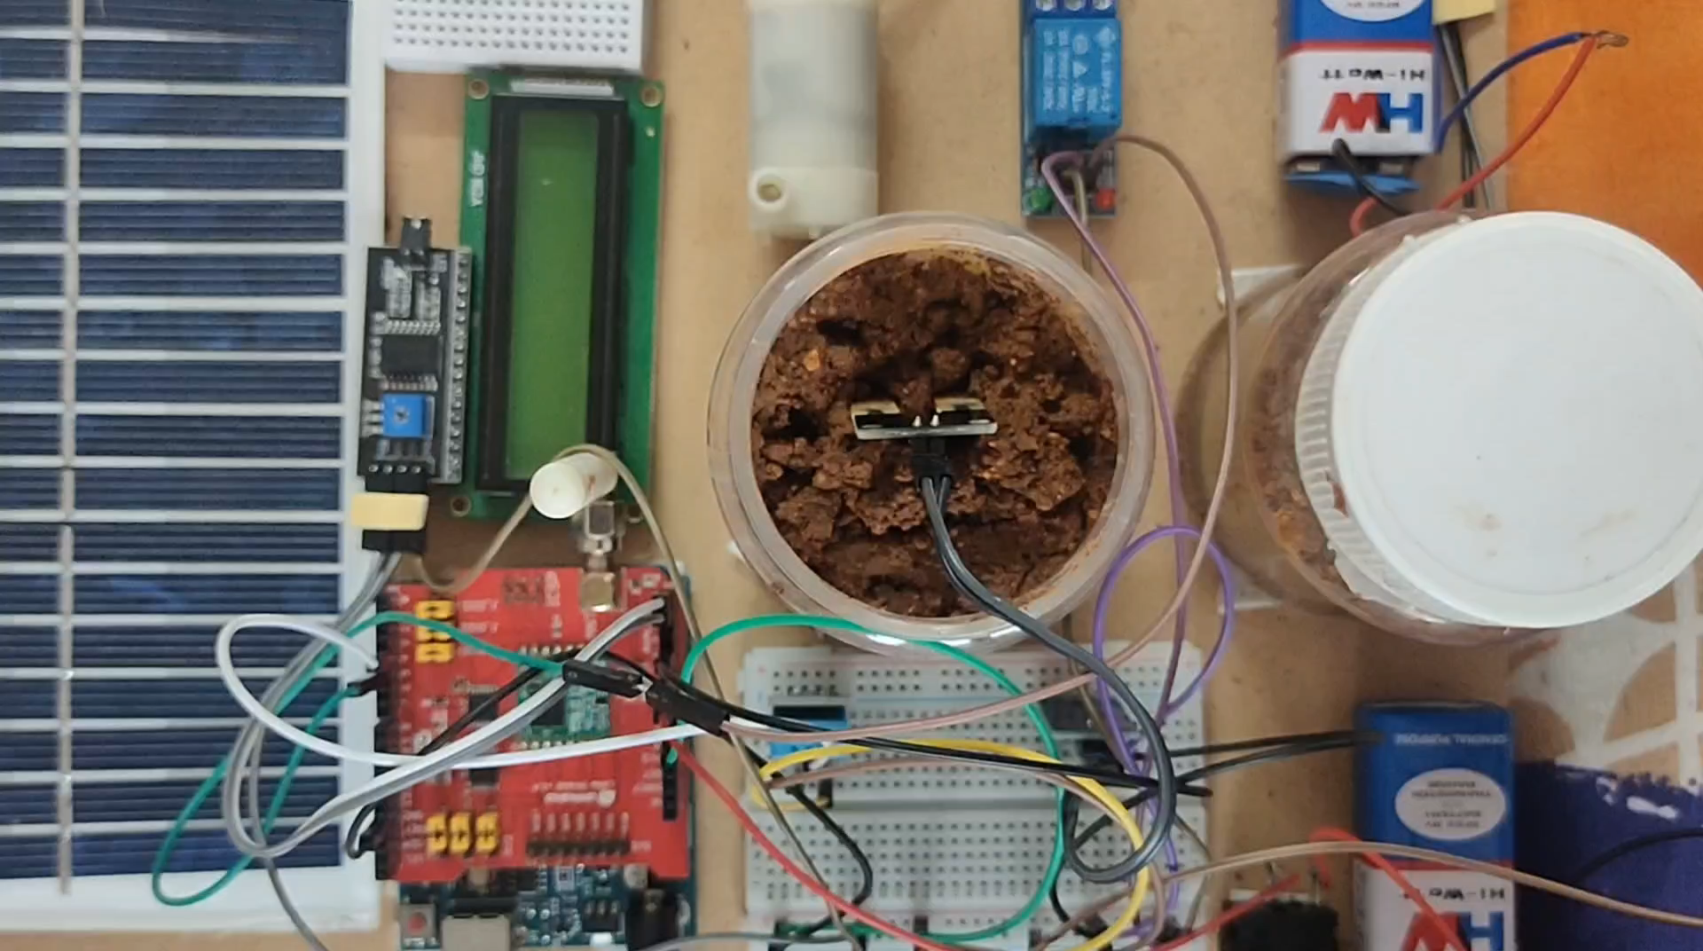
RESULTS

Slide 13
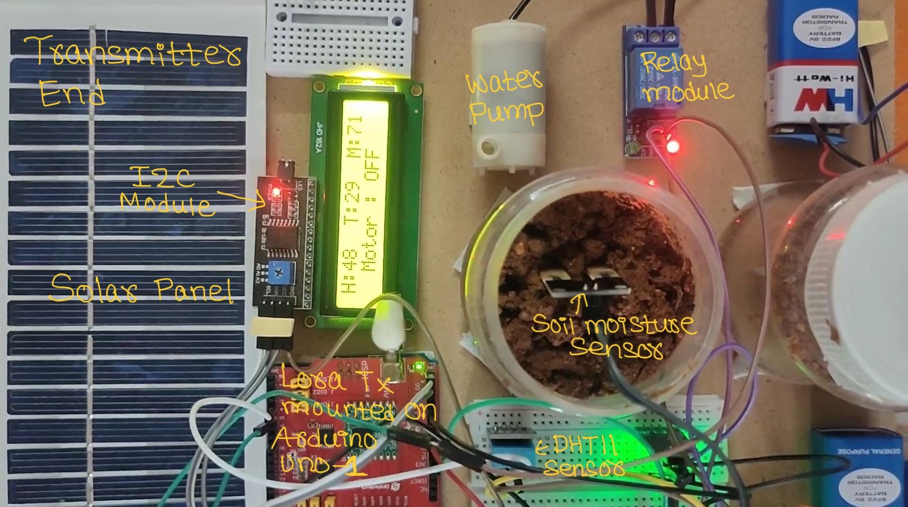
RESULTS
System at Transmitter end:

Slide 14
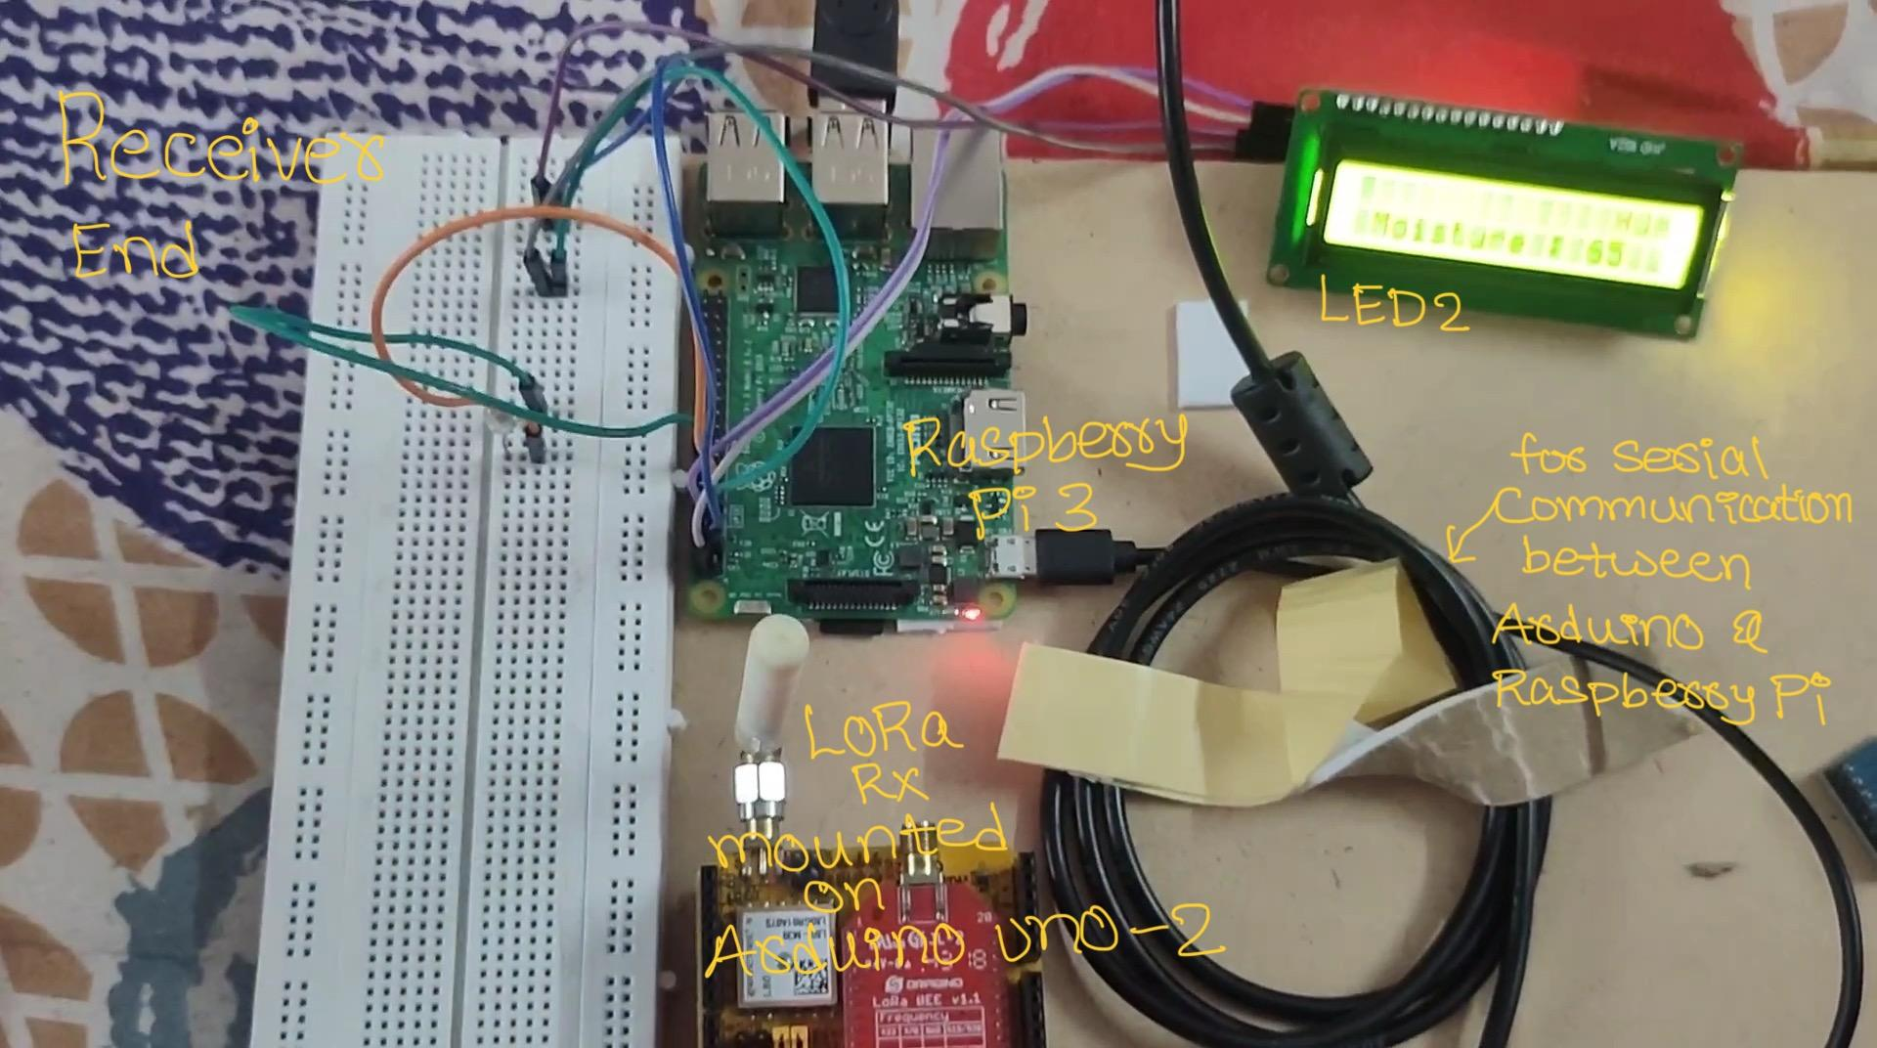
RESULTS
System at Receiver end:

Slide 15
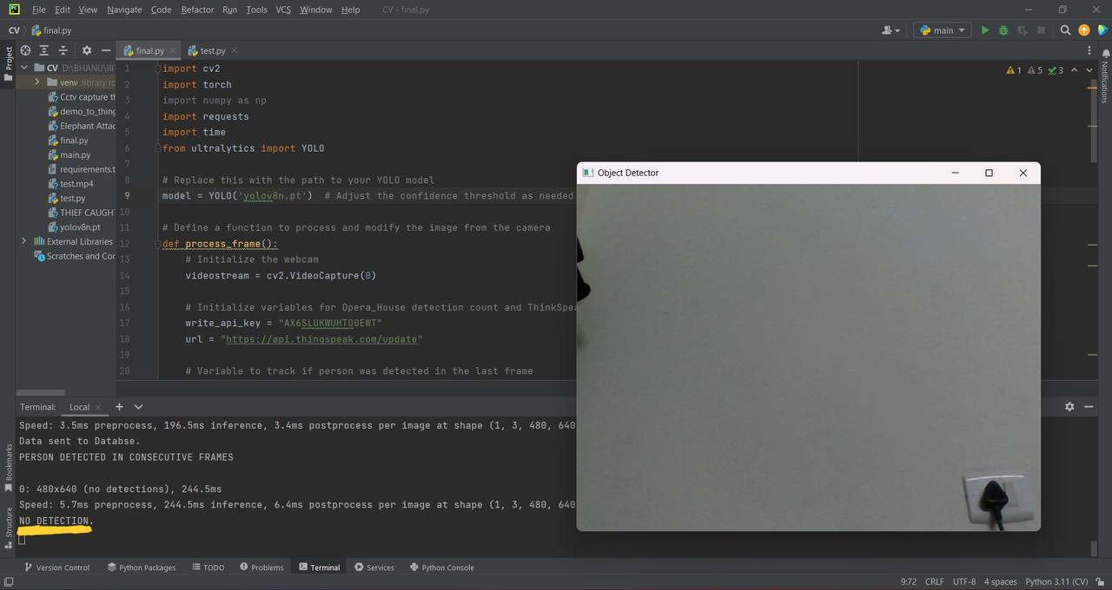
When no anomaly detected:
RESULTS

Slide 16
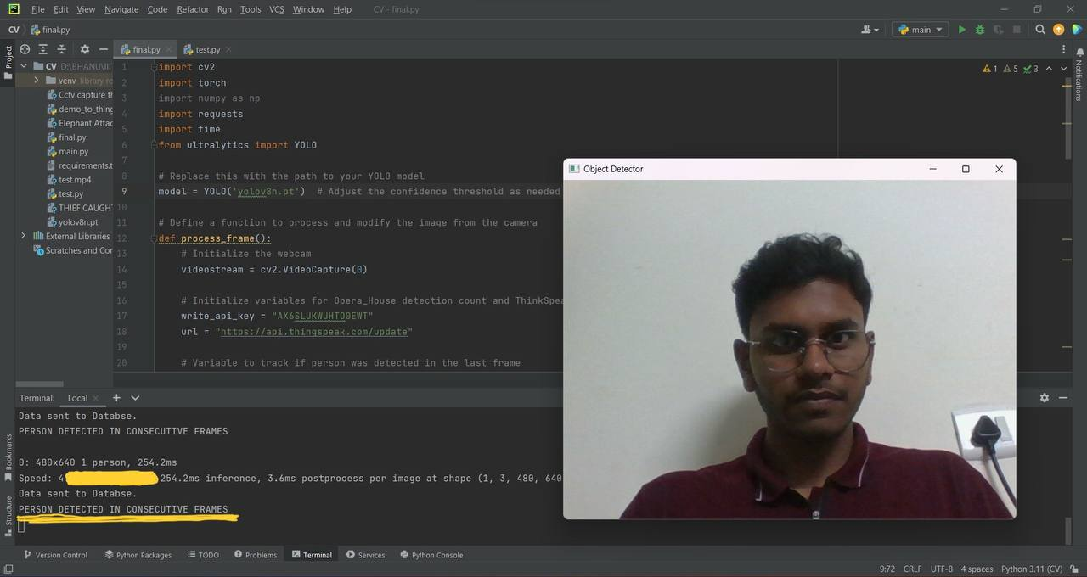
RESULTS
When anomaly detected:

Slide 17
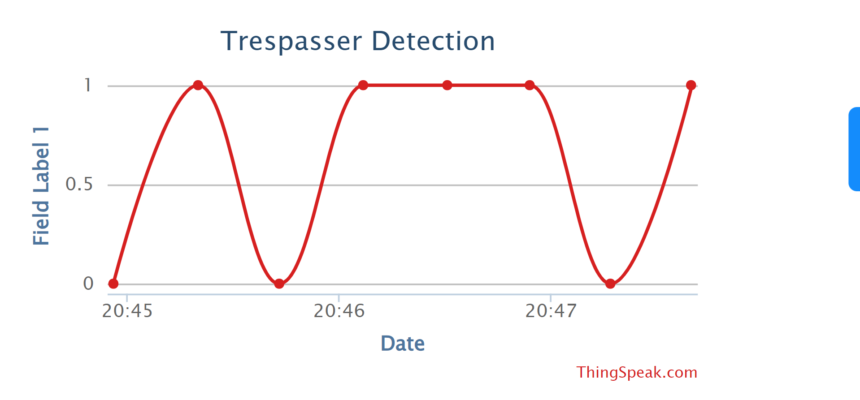
RESULTS
Data being sent to ThingSpeak database and updating in Real-Time:

Slide 18
CHALLENGES FACED
Establishing a Wi Fi connection with Raspberry Pi 3.
The hardware connections proved to be challenging especially with i2C module.
LoRaWAN won’t work as specified.
Ensuring accurate differentiate person, animals, and potential intruders, with a focus on minimizing false alarms.

Slide 19
CONCLUSION
Irrigation is initiated based on soil moisture levels, with the Arduino autonomously controlling the pump's operation.
The farmer can conveniently monitor the farm remotely from their home.
The system employs solar energy harvesting techniques for power efficiency.
Additionally, it incorporates computer vision for detecting trespassers and issuing alert messages when unauthorized individuals are detected.

Slide 20
REFERENCES
THILAGAVATHI, S., AISHWARYA RAJENDRAN, and K. PRIYADHARSHINI. "AUTOMATIC PLANT IRRIGATION SYSTEM." (2016).
S.Parthiban & V.P.Santhi & M.S.Snehapriya & K.Indumathi & P. Masilamani. "Recent Advances in Enhancing the Productivity of Mango through Hi-tech Practices." (2020).
J. -H. Kim, N. Kim and C. S. Won, "High-Speed Drone Detection Based On Yolo-V8," ICASSP 2023 - 2023 IEEE International Conference on Acoustics, Speech and Signal Processing (ICASSP), Rhodes Island, Greece, 2023, pp. 1-2, doi: 10.1109/ICASSP49357.2023.10095516.
Biswas, B., and Lalit Kumar. "Revolution of Mango production." Fertilizer Marketing News (2011): 1-24.

Slide 21
Thank you!

Slide 22
Questions?

